Slide 1

Approximating the solution to analytic equations

Slide 2
Introduction
In this topic, we will
  Describe what will be covered in the next section
    Approximating solutions to analytic equations
  Describe differential, integral and integro-differential equations
  Explain why we are focused on differential equations
  Look at the approach we will use

Slide 3
Analytic equations
In your calculus course, you have been introduced to two flavors of differential equations (des):
  Ordinary differential equations (odes)
  Partial differential equations (pdes)
Together with des, analytic equations can also contain integrals
  Engineers focus on des, but all techniques are applicable to:
    Differential equations
    Integral equations
    Integro-differential equations

Slide 4
Differential equations
An ordinary derivative is the derivative of a function of one variable with respect to that variable
A partial derivative is a derivative of a function of two or more variables with respect to one of those variables while holding the other variables constant
  Partial differentiation assumes no variable depends on the other variables

Slide 5
Analytic equations
A differential equation involves an unknown function and its derivatives
An integral equation involves an unknown function and its integrals:
An integro-differential equation involves an unknown function and its integrals and derivatives:
v(t)
+
R
L
–
v(t)
+
R
–
C
v(t)
+
R
L
–
C

Slide 6
Tools
By taking derivatives, integral and integro-differential equations can be converted to pure differential equations:
Maxwell’s equations can be written either as integral equations or partial differential equations
  To make life simple, engineers focus on differential equations

Slide 7
Analytic equations
In this section, we will look at:
  Approximating solutions to problems involving ordinary differential equations
  Approximating solutions to problems involving partial differential equations

Slide 8
Approach
In each case, we will be attempting to approximate a
continuous and differentiable function
  We cannot approximate such a function everywhere
  Instead, we will, for example, approximate the function
  at specific points and we can interpolate values in between

Slide 9
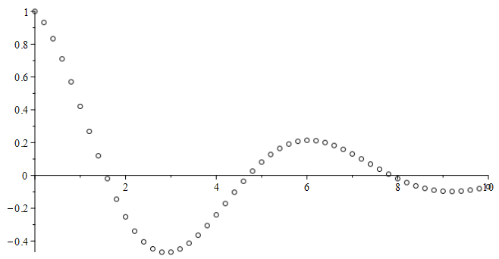
Approach
For example, if we are finding a function of one variable y(t),
we will approximate the function at points t_{k} and
find approximations y_{k} ≈ y(t_{k})
t

Slide 10
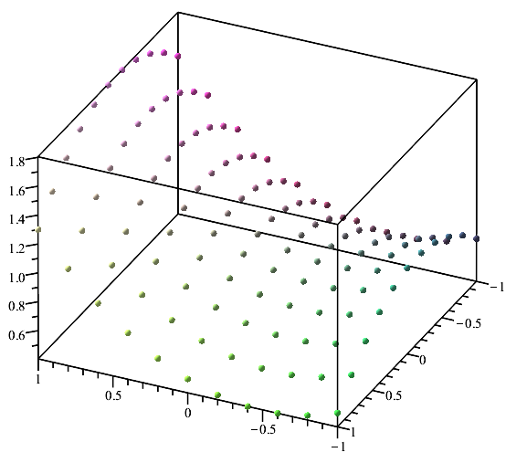
Approach
In finding a function of one two variables u(t, x),
we will approximate the function at points (t_{ℓ}, x_{k}) and
find approximations u_{ℓ},_{k} ≈ u(t_{ℓ}, x_{k})
x
t

Slide 11
Summary
Following this topic, you now
  Have an overview of the ideas to be covered in this section
  Are aware that there are differential, integral and intego-differential equations
  Understand we will focus on ordinary and partial differential equations
  Are aware of the approach we will use

Slide 12
References
[1] https://en.wikipedia.org/wiki/System_of_linear_equations
[2] https://en.wikipedia.org/wiki/Nonlinear_system

Slide 13
Acknowledgments
None so far.

Slide 14



Colophon
These slides were prepared using the Cambria typeface. Mathematical equations use Times New Roman, and source code is presented using Consolas. Mathematical equations are prepared in MathType by Design Science, Inc.
Examples may be formulated and checked using Maple by Maplesoft, Inc.
The photographs of flowers and a monarch butter appearing on the title slide and accenting the top of each other slide were taken at the Royal Botanical Gardens in October of 2017 by Douglas Wilhelm Harder. Please see
https://www.rbg.ca/
for more information.

Slide 15
Disclaimer
These slides are provided for the ece 204 Numerical methods course taught at the University of Waterloo. The material in it reflects the author’s best judgment in light of the information available to them at the time of preparation. Any reliance on these course slides by any party for any other purpose are the responsibility of such parties. The authors accept no responsibility for damages, if any, suffered by any party as a result of decisions made or actions based on these course slides for any other purpose than that for which it was intended.

